Slide 1

BANGALORE INSTITUTE OF TECHNOLOGY
K.R Road, V.V Pura, Bengaluru-04
DEPARTMENT OF ARTIFICIAL INTELLIGENCE & MACHINE LEARNING
“Leukemia Detection System”
Presented by
USN Name
1BI21AI047 Swarnava Chatterjee
1BI21AI055 Zoya Zaki
PID1
VI Semester
Under the Guidance of
Prof. Shobha Y
Associate Professor

Slide 2
Agenda
Introduction
Highlights of
Literature Survey
Requirement Engineering
System Design
Architecture
Module Decomposition/Description
Component Design
Interface Design
Data Structure Design
1/20

Slide 3
Agenda(contd..)
Algorithm Design
Implementation
Testing
Unit Testing
Integration Testing
Results

Slide 4
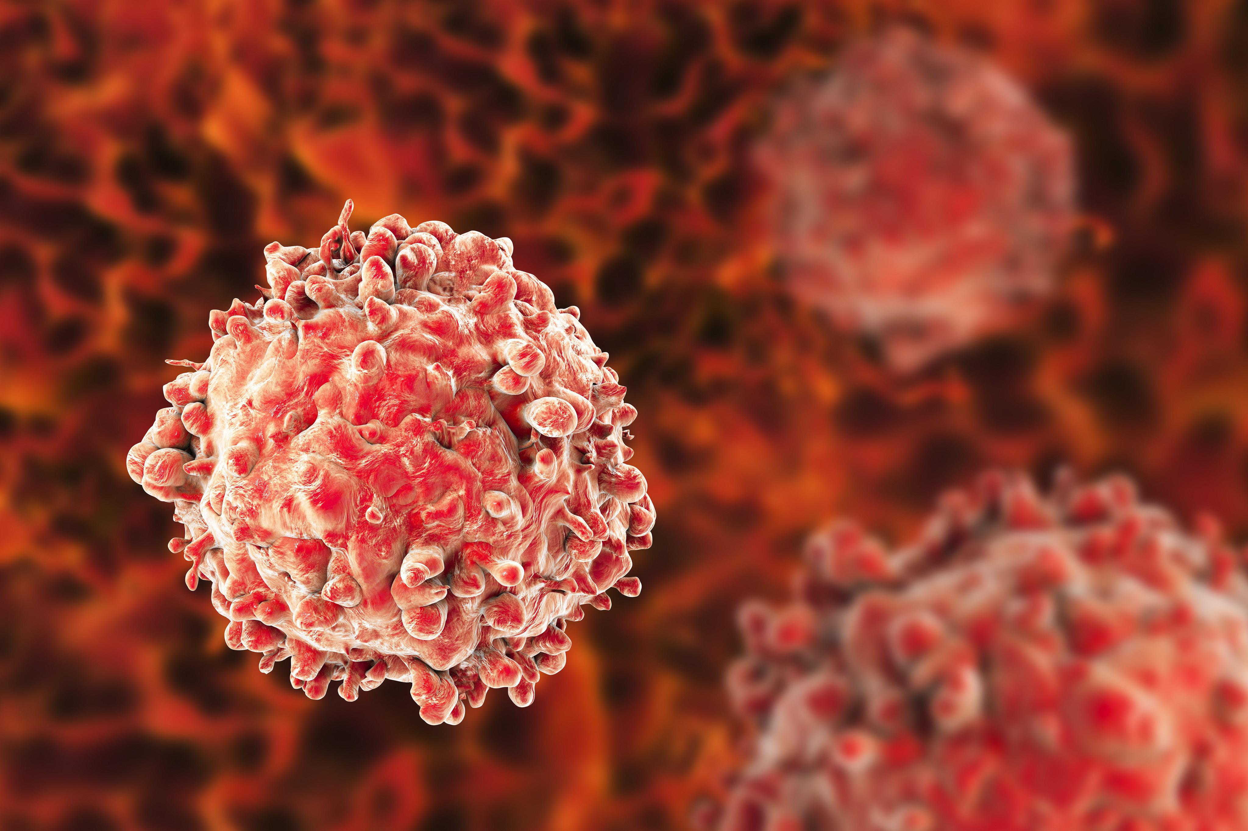
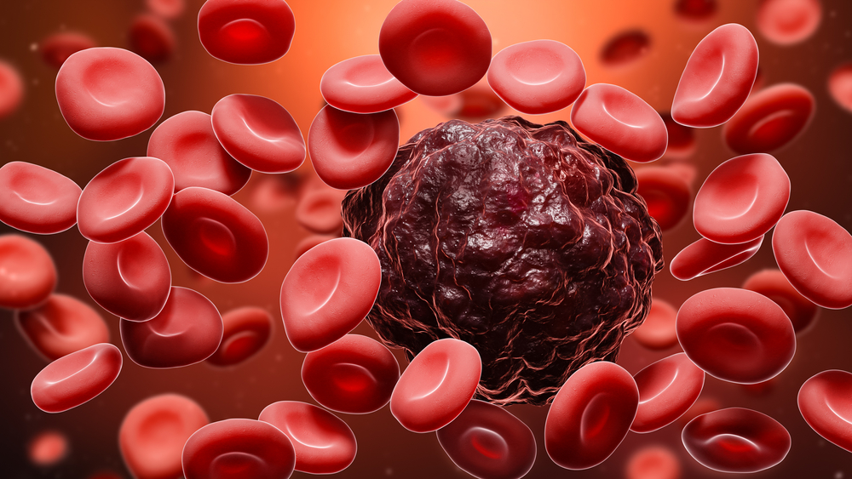
Introduction
Leukemia, a type of cancer affecting blood-forming tissues, including the bone marrow and lymphatic system, poses significant diagnostic challenges due to its varied presentation and complexity.
Fig. Leukemia WBC
2/20

Slide 5
Introduction Contd…
Advancements in machine learning, particularly Convolutional Neural Networks (CNNs), offer a promising solution to these challenges. CNNs are a class of deep learning algorithms that excel in image recognition and classification tasks by automatically learning to detect relevant features from raw image data. Leveraging CNNs for leukemia detection can enhance diagnostic accuracy, reduce the time required for analysis, and minimize errors.
Link → https://youtu.be/Qje0fG_JHLY?si=hnGnI9HJHJwYu4Wd
2/20

Slide 6
Objectives
To Facilitate Early Detection :Enable earlier detection of leukemia, leading to timely intervention and improved patient outcomes.
To Build a Scalable Solution: Create a system capable of efficiently processing large volumes of blood smear images, making it suitable for widespread clinical use.
To Ensure Accessibility and Usability: Design the system to be user-friendly and accessible to medical professionals in diverse settings, including remote and under-resourced areas.

Slide 7
Objectives Contd…
To Implement Rigorous Evaluation: Rigorously test and validate the model using comprehensive performance metrics (accuracy, sensitivity, specificity, AUC-ROC).
To Design Seamless Clinical Integration: Develop strategies for integrating the system into existing clinical workflows.
To Minimize Human Error: Reduce the risk of diagnostic errors associated with manual examination.

Slide 8
Literature Survey
Paper Title | Authors | Year | Methodology | Limitations
Automated Leukemia Diagnosis using Deep Learning | Johnson & Lee | 2021 | Employed transfer learning with pre-trained CNN models (VGG16, ResNet) | Limited dataset size
Comparative Study of CNN Architectures in Leukemia Detection | Davis et al. | 2021 | Compared various CNN architectures (ResNet, Inception, DenseNet) | High computational requirements
Enhancing Leukemia Classification with Data Augmentation | Kumar et al. | 2021 | Applied data augmentation techniques (rotation, flipping, scaling) | Augmentation sometimes led to overfitting
Real-Time Leukemia Detection Using CNNs | Brown & Williams | 2021 | Developed a real-time detection system using a custom lightweight CNN | Lower accuracy compared to heavier models
Improved Feature Extraction in Leukemia Detection | Garcia et al. | 2022 | Proposed a new feature extraction method using CNN-based autoencoders | Increased complexity and training time
Transfer Learning for Small Leukemia Datasets | Zhang & Li | 2022 | Applied transfer learning with fine-tuning on small leukemia datasets | Dependency on pre-trained models
CNN-based Leukemia Detection: A Review | Nguyen et al. | 2023 | Reviewed various CNN-based approaches, including hybrid models and ensemble techniques | Limited empirical evaluations
Hybrid CNN and RNN Model for Leukemia Detection | Patel & Wang | 2023 | Combined CNNs for feature extraction with RNNs for sequential data processing | Increased computational complexity
EfficientNet for Leukemia Image Classification | Kim et al. | 2023 | Utilized EfficientNet architecture, achieving high performance with fewer parameters | High resource demand for training
Robustness of CNN Models in Leukemia Detection | Ahmed & Jones | 2023 | Analyzed model robustness to variations in image quality and noise | Limited to synthetic noise conditions
5/20

Slide 9
Literature Survey Contd…
Paper Title | Authors | Year | Methodology | Limitations
CNN-based System for Pediatric Leukemia Detection | Chen et al. | 2023 | Developed a specialized CNN model for pediatric leukemia detection | Smaller dataset and potential bias towards pediatric cases
Comparative Study on Image Preprocessing Techniques | Singh & Kumar | 2024 | Compared preprocessing techniques such as normalization, contrast enhancement, and noise reduction | Preprocessing steps increased pipeline complexity
Lightweight CNN Models for Mobile Leukemia Detection | Park et al. | 2024 | Proposed lightweight CNN models optimized for mobile devices | Potential trade-off between model size and accuracy
Explainable AI in Leukemia Detection using CNNs | Evans et al. | 2024 | Emphasized explainability by using visualization techniques (Grad-CAM) for CNN predictions | Explainability techniques sometimes lacked precision
Self-Supervised Learning for Leukemia Detection | Hughes et al. | 2024 | Used self-supervised learning to improve feature representation without extensive labeled data | Performance heavily dependent on the quality of pretext tasks
Multi-Modal CNN for Leukemia Detection | Zhao et al. | 2024 | Integrated multi-modal data (e.g., blood smear images and patient metadata) for improved accuracy | Complexity in integrating and processing multi-modal data
Adversarial Training for Robust Leukemia Detection | Martinez & Clark | 2024 | Employed adversarial training techniques to enhance model robustness against adversarial attacks | Computationally intensive training process
Few-Shot Learning for Rare Leukemia Subtypes | Williams et al. | 2024 | Applied few-shot learning to detect rare leukemia subtypes with limited examples | Difficulty in selecting optimal few-shot learning algorithms
5/20

Slide 10
Drawbacks of Existing System
High Costs: Advanced tests such as genetic profiling and bone marrow biopsies can be expensive.
Invasive Procedures :Bone Marrow Biopsy is painful and carries risks such as infection or bleeding.
Continuous Monitoring: Frequent tests and monitoring can be uncomfortable and burdensome for patients.
Accuracy and Specificity: Tests can sometimes yield false positives or negatives, leading to misdiagnosis or delayed diagnosis.
6/20

Slide 11
Drawbacks of Existing System
Limited Accessibility : Access to advanced diagnostic tools and specialized care can be limited in remote or underserved areas.
Treatment Delays: There can be delays in starting treatment due to waiting for results or availability of specialists.
Psychological Impact: The diagnostic process can be stressful for patients and their families, especially if the tests are inconclusive or if there are long waiting periods.
6/20

Slide 12
Problem Statement
“Development of a Convolutional Neural Network-Based System for Early Detection of Leukemia.”
Input: The dataset used for training and evaluating the CNN model consists of microscopic images of blood cells.
Image Resolution: The resolution of the images can vary, but they are generally standardized to a specific size (e.g., 256x256 pixels) for input into the CNN.
3/20

Slide 13
Problem Statement
Color Channels: Images may be in RGB color space, containing three color channels (Red, Green, and Blue).
File Format: Images can be stored in common formats such as JPEG or PNG.
Output : The model outputs one of two class labels:
Leukemia: The image shows characteristics of leukemia.
Normal: The image does not show characteristics of leukemia.
3/20

Slide 14
Proposed System
The CNN model is trained on a diverse dataset of blood cell images using transfer learning techniques to improve its accuracy and generalization. It involves the development of a deep learning model that uses convolutional layers for feature extraction, pooling layers for down-sampling, and fully connected layers for classification. Selective partitioning involves dividing the dataset into smaller, more manageable subsets .
7/20

Slide 15
Proposed System Contd..
Criteria for Partitioning: Blood cell images can be partitioned based on factors like:
Patient age groups
Image characteristics (e.g., staining method, image resolution)
Data Replication Strategy: To ensure availability, fault tolerance, and quicker access times,
High-Usage Data: Frequently accessed images or data subsets are replicated across multiple nodes.
7/20

Slide 16
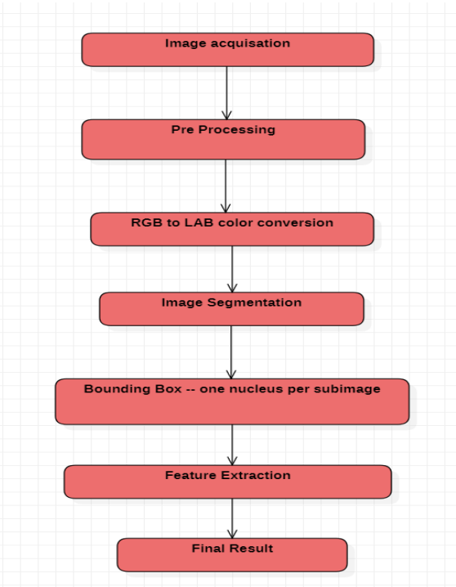
Proposed System Contd…
Fig. Selected Methodology / Process Model
7/20

Slide 17
Requirement Engineering
Software Requirements Specification Documentation
Pycharm: Provides features such as code completion, debugging, version control, and syntax highlighting.
Python: A high-level programming language.
Machine Learning, CNN & AI
Git and Github :We used Git and GitHub for version control of our code.

Slide 18
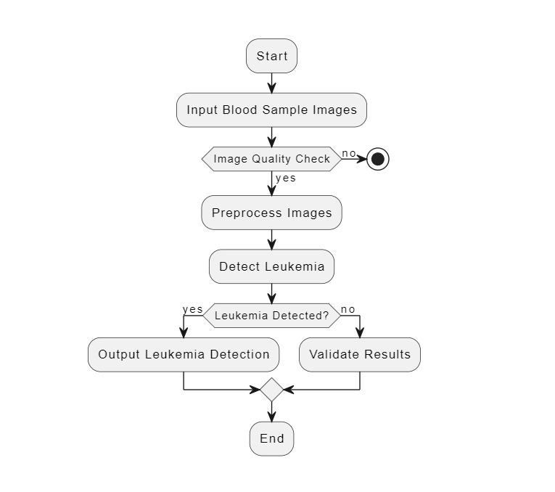
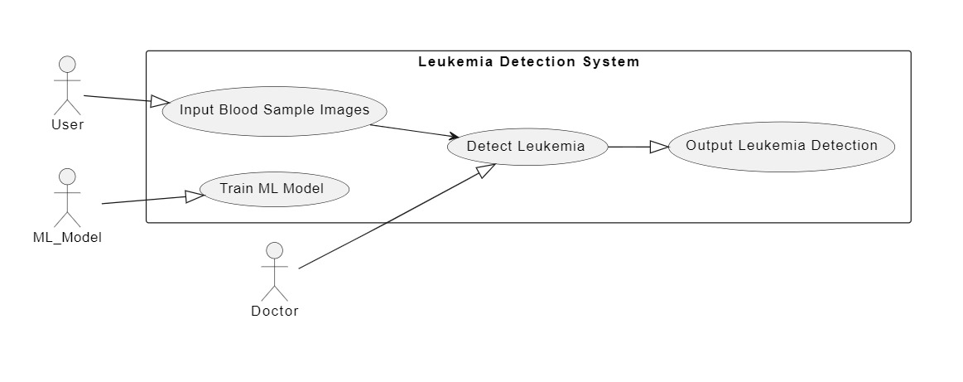
Conceptual/Analysis Modelling
1. Object Oriented Models:
Fig. Use Case Diagram
Fig. Activity Diagram

Slide 19
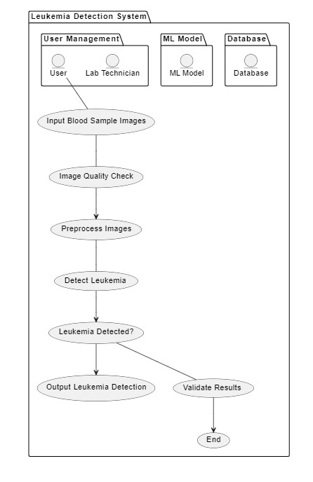
Conceptual/Analysis Modelling
2. Structured Development Models:
Fig. System Flowchart

Slide 20
Software Requirements Specification
Functional Requirements
The system should allow medical professionals to upload blood cell images for analysis.
The system should allow medical professionals to view the results of the analysis in a user-friendly format.
The system should implement a CNN model for the classification of leukemia in blood cell images.
The system should perform training and validation of the CNN model using a diverse dataset of blood cell images.

Slide 21
Software Requirements Specification
Non Functional Requirements
The system should provide real-time analysis of blood cell images.
The system should have high accuracy and precision in the classification of leukemia in blood cell images.
The system should be reliable.
The system should have high performance and low latency.
The system should be compatible with different operating systems and browsers.

Slide 22
System Design
System Architecture
22/20

Slide 23
Module Decomposition
List the modules identified:
Example:
Alarm
23/20

Slide 24
Module Description ( for every module)
Notes:
OLD POINTS:
Scheduler module manages the asynchronous generation of the new Request objects.
The new Request Object is downloaded and Updated just once through the entire process.
debugging and testing facility directly from this module without requiring user interaction with android application.

Slide 25
Component Design/ Detailed Class Diagram
Detailed explanation about the components involved in the modules
Each class represents a component
Example :
Alarm: how the Alarm is implemented.
25/20

Slide 26
Interface Design
User interaction with the system(GUI)
Component to Component interaction(in case of incompatible components).
Example:
component to database(vice versa)
26/20

Slide 27
Data Structure Design
Example:
Alarm can be treated as a class/data member of a class.
27/20

Slide 28
Algorithms
Write an algorithm used to implement the modules.
Explain each algorithm with suitable example using all the necessary diagrams.
Note: Students are supposed to modify the existing algorithm in case of built in functions/ methods/ API’s used.(if not write the algorithm in the context of the mini project).
28/20

Slide 29
Implementation
Pseudocode/ Algorithm source code from the implementation part to be explained.

Slide 30

Pseudocode:
alarm:
set the alarm
snooze: set the snooze time
wrap at max
if not setting
reset all repeat rate counters
display the current value of time, alarm, or snooze

Slide 31
Implementation (Important Functions only)
public class Alarm extends Clock
{
public int alarmHour;
public int alarmMinute;
public int alarmSecond;
public AlarmClock()
{
super();
alarmHour = 0;
alarmMinute = 0;
alarmSecond = 0;
}
public AlarmClock(int theHour, int theMinute, int theSecond, int alarmH, int alarmM, int armS)
{
super(theHour, theMinute, theSecond);
setAlarmHour(alarmH);
setAlarmMinute(alarmM);
setAlarmSecond(alarmS);
}
public void SetAlarm(int alarmH)
{
if((alarmH >= 0) && (alarmH <= 24))
alarmHour = alarmH;
}
Notes:
Implementation:
Our Project UI and search Engine is developed within an android application package (apk). We used android studio supporting sdk 27+, the 3rd party API’s used are Glide, Picasso for image loading and handling. The leg of the application is “digitizing document”. Using camera intent we capture the image of the document. Then we upload the image to firebase storage by getting reference of firebase storage as shown in the snippet
Then the document along with necessary data such as document name are entered by the users. This is converted into a document object which is then placed as JSON object within our realtime database. The name realtime database is given cuz multiple device and program can simultaneously listen to the changes occurring for a document Object.
The search Engine logic is shown here, it iteratively searches and ranks based on level of the first hit. Then populates an a custom document list. Which is then passed on to the list adapter to display the list.
On clicking the user can view the details of the digitized text and we have used TEXT_To_Speech API to read text out aloud to the users.

Slide 32
Testing
Unit Testing:
Alarm(Component Name)
Test case 1:
SetAlarm( ): Description in a line or two.
Minimum 3 test data to be included.(1-valid test data and 2 invalid test data)
Test # | Test Data(input) | Expected Result | Actual Result | Pass/ Fail
1 | Time set to 4:00 PM | Alarm at 4:00 PM | Alarm at 4:00 PM | Pass
2 | Time set to 4:00 | Alarm should not be generated | If alarm is generated at 4 :00 Am or 4:00Pm | Fail
3 | Time set to 25:00 PM | Generate an error message saying Invalid Input | Anything other than expected | Fail

Slide 33
Integrated manual testing
(Integrate methods within the component and test/Integrate the components and test)
Alarm and UI(Component and Component )
Test case 1:
SetAlarm( ) and UI: Description in a line or two.
Minimum 3 test data to be included.(1-valid test data and 2 invalid test data)
Test # | Test Data(input) | Expected Result | Actual Result | Pass/ Fail
1 | Time set to 14:00 PM | Time set on the UI is reflected in database | Time set on the UI is reflected in database | Pass
2 | Time set to 24:00 | Displays message using UI to the user to provide AM/PM | Do not display any message | Fail
3 | Time set to -5:00 PM | Generate an error message on UI saying Invalid Input | Anything other than expected | Fail

Slide 34
Snapshots (optional)

Slide 35
Conclusion
35/20

Slide 36
References
[1]Author name. “Title”, Publication details, Vol., No., Page No., Year.
21

